Slide 1



SRM INSTITUTE OF SCIENCE AND TECHNOLOGY
SCHOOL OF COMPUTING
DEPARTMENT OF COMPUTING TECHNOLOGIES
21CSP302L - MINOR PROJECT
Edge Preserving Enhancement of Spinal Anatomy in Low-Field MRI
Batch ID: B929
Student 1 Reg. No: RA2311003011460
Student 1 Name: T Barathkalyan
Student 2 Reg. No: RA2311003011470
Student 2 Name: Sarukeshwar S
Guide name: Dr.E. Poovammal
Designation: Professor
Department: C.Tech

Slide 2
Problem Statement
Low-field MRI (0.1–0.5 T) produces 3–6× noisier images
Causes blurred disc edges & unclear nerve compression
Reduces fat–fluid contrast → affects diagnosis
Existing solutions rely on AI super-resolutionNeed large paired datasets
Require high-end GPUs
Act as black-box models (low interpretability)
Not practical for small clinics or real-world deployment

Slide 3
Objectives
To Simulate realistic low-field MRI from high-field data by modeling noise and resolution loss
Develop a structured enhancement pipeline for systematic image restoration
Improve contrast, clarity, and anatomical visibility for better diagnosis
Preserve structural integrity and avoid distortion of anatomical details
Evaluate performance using PSNR, SSIM, and SNR against high-field reference
Build a fast, interpretable, non-AI solution suitable for real-world use

Slide 4
Literature Review
Work | Method | Limitation
Arnold et al. (2022) | Simulated low-field MRI from high-field using noise + smoothing | Does not fully model real low-field physics
Setty et al. (2014) | Multi-scale Retinex for contrast enhancement | High complexity, limited clinical validation
Arnold et al. (2023) | Review of low-field MRI applications and challenges | No experimental validation
Salehi et al. (2025) | Deep learning (U-Net) for denoising low-field MRI | Requires large data, limited real-world validation
Kaur et al. (2016) | Histogram-based contrast enhancement (CLAHE, HE) | May amplify noise, lacks advanced comparison

Slide 5
Literature Review
Work | Method | Limitation
Tustison et al. (2010) | N4 bias field correction method | Parameter-sensitive, computational cost
Isa et al. (2017) | Adaptive histogram-based enhancement (AIR-AHE) | Small dataset, limited generalization
Fish et al. (1995) | Richardson–Lucy deconvolution | Sensitive to noise, high iterations required

Slide 6
Literature Review
Research Gap:
No end-to-end classical pipeline for low-field lumbar spine MRI enhancement
Existing methods address only individual steps (denoising, contrast, etc.)
Heavy reliance on deep learning approaches
Limited interpretability and reproducibility
Lack of validation on real low-field lumbar spine data

Slide 7
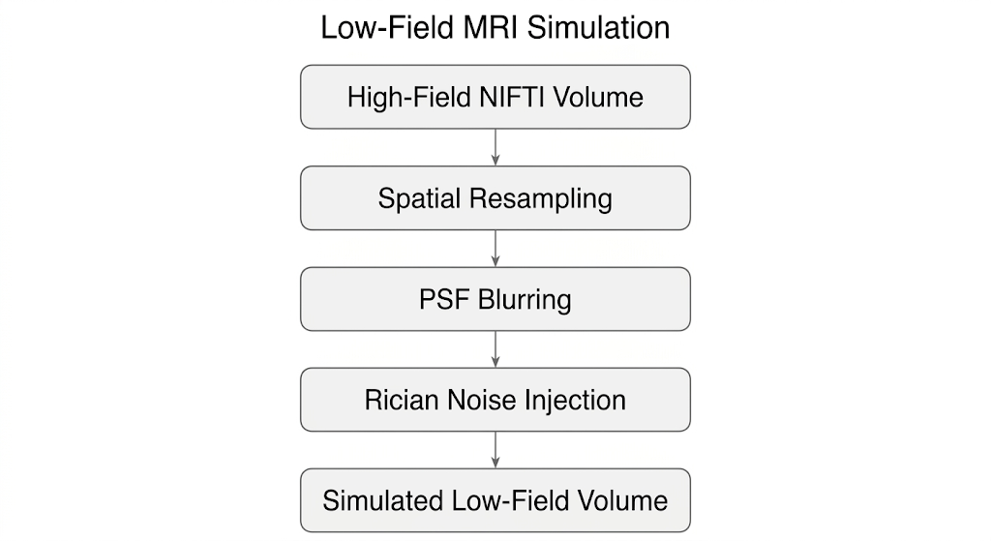
Proposed Methodology

Slide 8
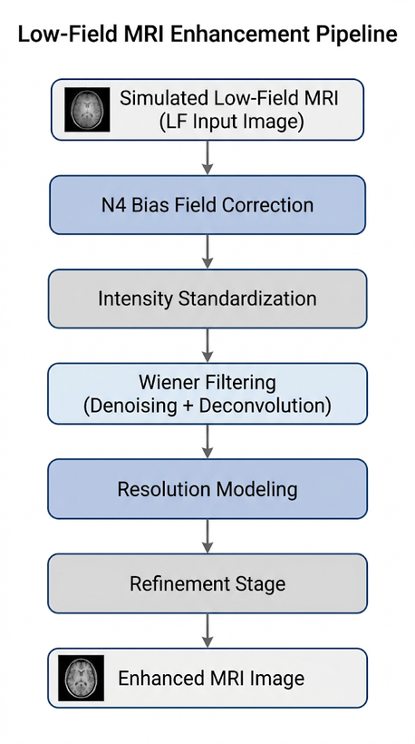
Proposed Methodology

Slide 9
Proposed Methodology
N4 Bias Field Correction: Removes low-frequency intensity inhomogeneity to achieve uniform signal distribution
Intensity Standardization: Aligns intensity distribution for consistent processing across all scans
Wiener Filtering (Denoising + Deconvolution): Reduces noise while preserving structural details and improving sharpness
Resolution Modeling: Compensates for resolution loss and restores anatomical clarity
Refinement Stage: Applies mild smoothing and stabilization to avoid artifacts
Final Output (Enhanced MRI): Produces improved SNR and better structural visibility while maintaining realism

Slide 10
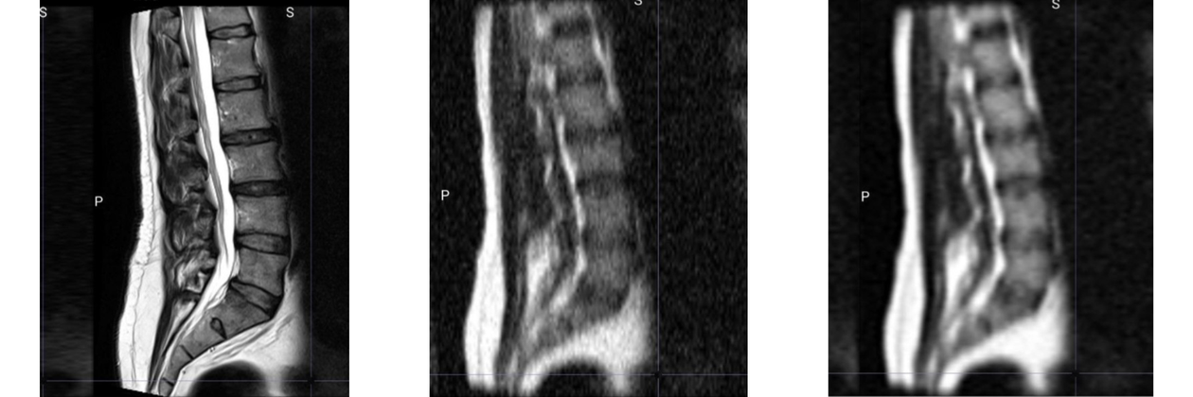
Results
HF Original → LF Simulated → Enhanced Output
Enhanced image shows improved SNR, sharper edges, and better anatomical visibility

Slide 11
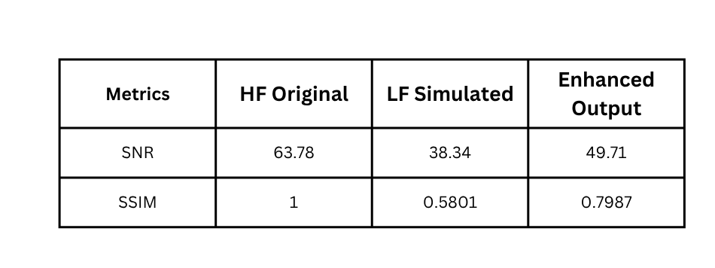
Results
Representative Example: Patient 004
Improved edge sharpness and disc boundary visibility
Structural details preserved without distortion
Clear reduction in noise and background artifacts

Slide 12
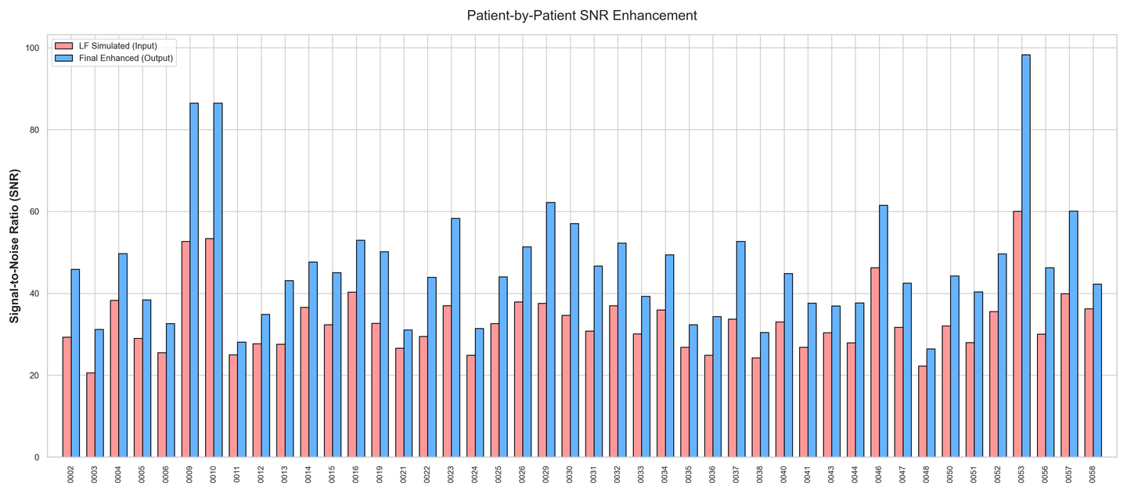
Results
Above Graph shows patient-wise comparison of SNR before and after enhancement
SNR improvement observed consistently across all patient scans

Slide 13
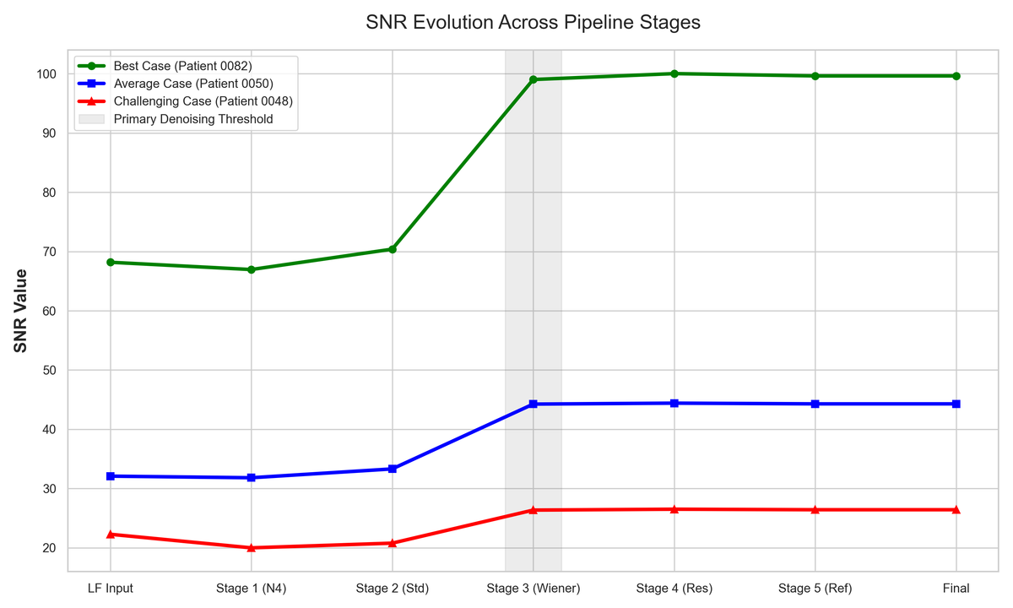
Results
Above Graph shows SNR progression across pipeline stages.
Major improvement observed after Wiener filtering stage.
Pipeline effectively balances noise reduction and detail preservation

Slide 14
SDG Mapping
This research aligns with the following United Nations Sustainable Development Goals:
• SDG 3 – Good Health and Well-Being: Improves diagnostic quality in low-resource and rural settings
• SDG 9 – Industry, Innovation, and Infrastructure: Enables cost-effective and efficient medical imaging solutions
• SDG 10 – Reduced Inequalities: Enhances accessibility of advanced imaging in underserved areas

Slide 15
Conclusion
• Developed a classical pipeline for enhancing low-field lumbar spine MRI images
• Simulated realistic low-field characteristics from high-field data
• Achieved improved contrast, noise reduction, and structural clarity
• Preserved anatomical details without introducing distortion
• Quantitative metrics (SNR, SSIM, PSNR) show consistent improvement
• Performance approaches deep learning-based methods under moderate conditions, without requiring large datasets or GPUs
• Provides a simple, interpretable, and computationally efficient solution

Slide 16
References
• Sheth et al., Portable low-field MRI for Alzheimer’s disease, Nature Communications, 2024
• Arnold et al., Simulated diagnostic performance of low-field MRI, Magnetic Resonance Imaging, 2022
• Salehi et al., Denoising low-field MR images using deep learning, Journal of Magnetic Resonance, 2025
• Gupta et al., Image denoising using BM4D filtering, Scientific Reports, 2023
• Manjón et al., Adaptive non-local means denoising of MR images, Journal of Magnetic Resonance Imaging, 2010
• Erwin et al., Image enhancement using CLAHE and filtering methods, IJIGSP, 2020
• Ayde et al., Zero-shot deep learning denoising for low-field MRI, MAGMA, 2025
• Dabov et al., BM3D image denoising method, IEEE Transactions on Image Processing, 2007

